Slide 1
OS MINOR PROJECT
MESSAGE &FILE
ENCRYPTION
& DECRYPTION

Slide 2
BY
171FA04428
171FA04462
171FA04488

Slide 3
Index
01
INTRODUCTION
02
METHODOLOGY
03
IMPLEMENTATION
04
CONCLUSION

Slide 4
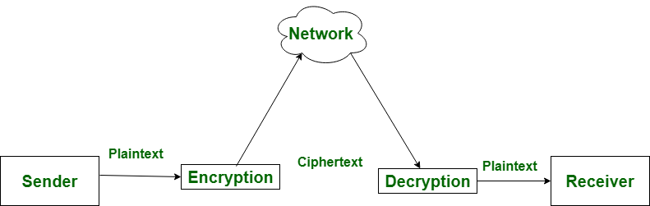
INTRODUCTION
Encryption is the process of converting normal message (plain text) into
meaningless message (Cipher text).
Decryption is the process of converting meaningless message (Cipher text)
into its original form (Plain text).

Slide 5
Process Requirements
Requirement 1
Decryption process needs to use
the same key that is used in the
encryption process to obtain
original plaintext.
Requirement 2
Although one may obtain a copy of
the encrypted message, one must
use the correct key to successfully
decrypt the message

Slide 6
Software & hardware requirements
Tool 1
Tool 2
Tool 3
Processor i3
RAM 2GB
ROM 256GB
Software &
hardware
Tools
Tool 4
Tool 5
Tool 6
Editor spyder
Compiler python 3.7
Os windows

Slide 7
Methodology
This program is having two option those are
Message encryption or decryption.
File encryption and decryption.
We should chose any of them,after that we should give the input for encryption or decryption.
In this program the we used some modules by which the process of encryption and decryption is done easily.
By importing those modules we can use some inbuild functions like encrypt(),decrypt() etc.,
For encrypting or decrypting we should give some password which acts as a key for conversion.
If the password given at encryption and decryption are not same then the message can not be converted.
Key

Slide 8
Algorithm
Step1:import required modules.
Step2:read a variable to ensure that it is file encryption or message encryption
Step3:define encrypt function and write code for encryption
Step4:define decrypt function and write code for decryption
Step5:write a loop to repeat the process.
Step6:if the process is completed exit.

Slide 9
implementation
import os from Crypto.Cipher import AES from Crypto.Hash import SHA256 from Crypto import Random import base64 import hashlib from Crypto.Cipher import AES print("for message encryption and decryption enter m\nfor file encryption and decryption enter f") h=input()
if(h=='m'or h=='M'): BLOCK_SIZE = 16 pad = lambda s: s + (BLOCK_SIZE - len(s) % BLOCK_SIZE) * chr(BLOCK_SIZE - len(s) % BLOCK_SIZE) unpad = lambda s: s[:-ord(s[len(s) - 1:])] i=input("enter message:")

Slide 10
implementation
password = input("Enter encryption password: ") def encrypt(raw, password):
private_key = hashlib.sha256(password.encode("utf-8")).digest() raw = pad(raw) iv = Random.new().read(AES.block_size) cipher = AES.new(private_key, AES.MODE_CBC, iv) return base64.b64encode(iv + cipher.encrypt(raw)) def decrypt(enc, password):
private_key = hashlib.sha256(password.encode("utf-8")).digest() enc = base64.b64decode(enc) iv = enc[:16] cipher = AES.new(private_key, AES.MODE_CBC, iv) return unpad(cipher.decrypt(enc[16:]))

Slide 11
implementation
while(True): h=input("enter e for encryption and d for decryption: ") if h=='e': encrypted = encrypt(i, password) print(encrypted) if h=='d': decrypted = decrypt(encrypted, password) print(bytes.decode(decrypted)) break
if(h=='f'or h=='F'): def encrypt(key, filename): chunksize =64 * 1024 outputFile = "encrypted"+filename filesize = str(os.path.getsize(filename)).zfill(16) IV = Random.new().read(16) encryptor = AES.new(key, AES.MODE_CBC, IV)

Slide 12
implementation
with open(filename, 'rb') as infile: with open(outputFile, 'wb') as outfile: outfile.write(filesize.encode('utf-8')) outfile.write(IV) while True: chunk = infile.read(chunksize) if len(chunk) == 0: break elif len(chunk) % 16 != 0: chunk +=b' ' * (16 - (len(chunk) % 16)) outfile.write(encryptor.encrypt(chunk)) def decrypt(key, filename): chunksize =64 * 1024 outputFile = filename[11:]

Slide 13
implementation
with open(filename, 'rb') as infile: filesize = int(infile.read(16)) IV = infile.read(16) decryptor = AES.new(key, AES.MODE_CBC, IV) with open(outputFile, 'wb') as outfile: while True: chunk = infile.read(chunksize) if len(chunk) == 0: break outfile.write(decryptor.decrypt(chunk)) def getKey(password): hasher = SHA256.new(password.encode('utf-8')) return hasher.digest()

Slide 14
implementation
def Main(): choice = input("Would you like to (E)ncrypt or (D)ecrypt?: ") if choice == 'E' or choice == 'e': filename = input("File to encrypt: ") password = input("Password: ") encrypt(getKey(password), filename) print("Done.") elif choice=='d' or choice=='D': filename = input("File to decrypt: ") password = input("Password: ") decrypt(getKey(password), filename) print("Done.") else: print("No Option selected, closing…") if __name__ == '__main__': Main()

Slide 15
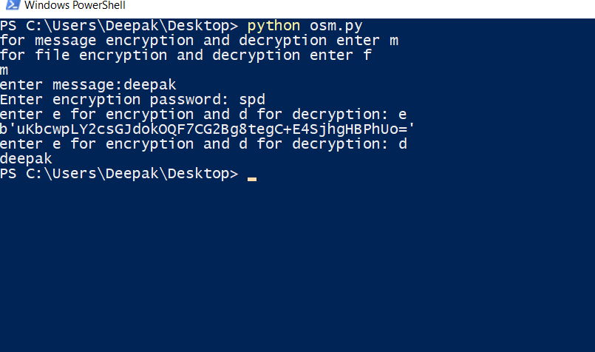
output

Slide 16
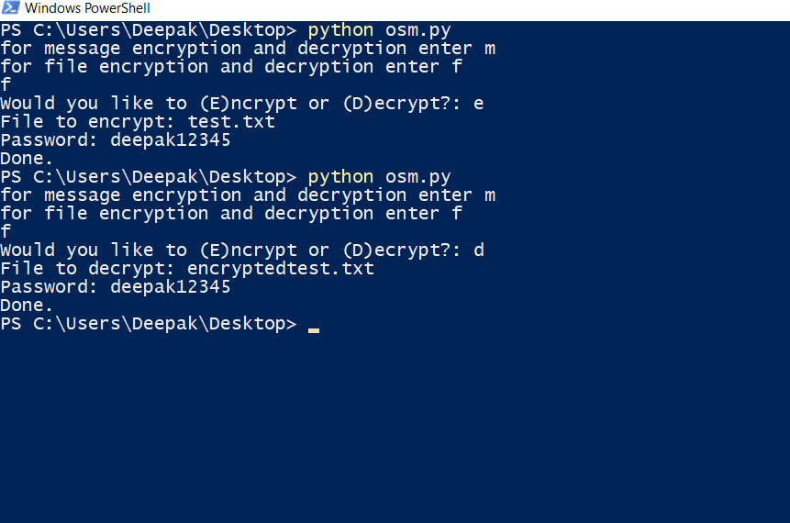
output

Slide 17
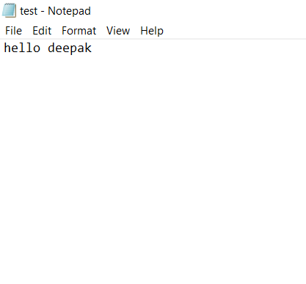
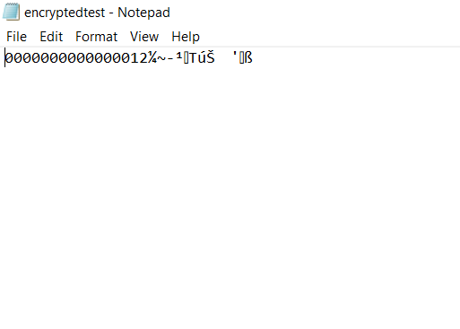
output

Slide 18
ADVANTAGES
1.Provides security
2.File encryption
3.Message encryption and decryption
4.Password manager
5.Easy implementation
DISADVANTAGES
1.File decryption may not possible.
2.Difficult to understand.
3.Modules used are not provided by IDE

Slide 19
CONCLUSION
By this program we can provide security to message so that
unauthorized persons can’t view the original message.

Slide 20
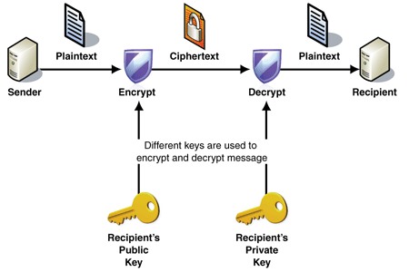
OVERVIEW

Slide 21
Thank you !

